Slide 1
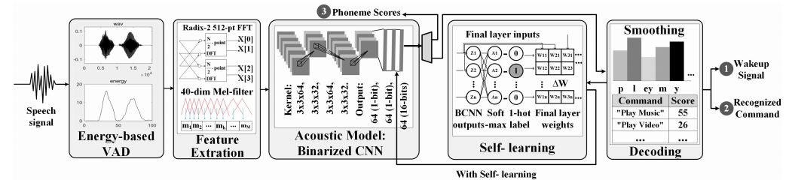
ASR System

Slide 2
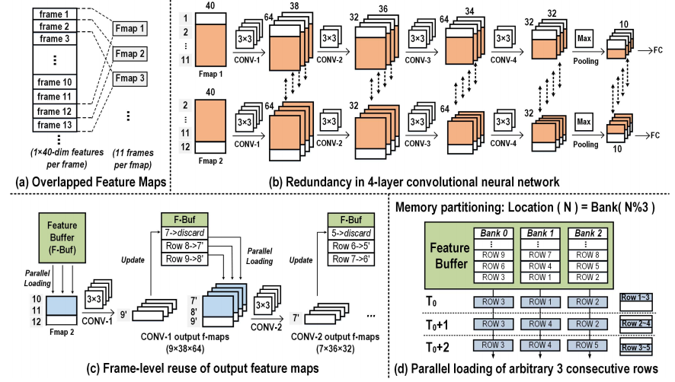
Computing Flow an Frame Reuse

Slide 3
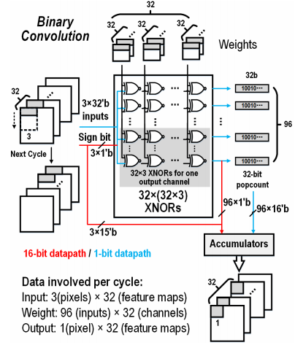
XNOR Array
32 Input channels
32 output channels
3 weight pixels

Slide 4
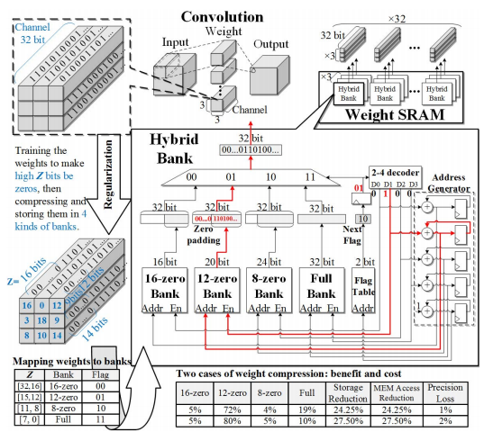
Weight Compression

Slide 5
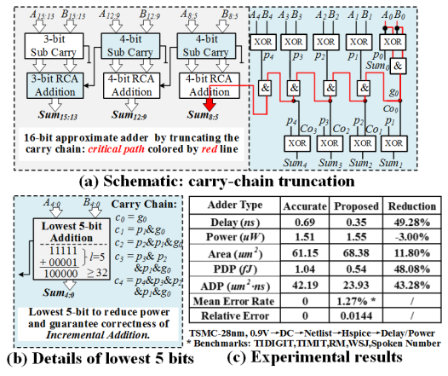
Addr Carry Chain
Since the
number of input channels being concurrently operated is at
most 32, the maximum result of popcount is also 32, which
takes 5 bits to represent.

Slide 6
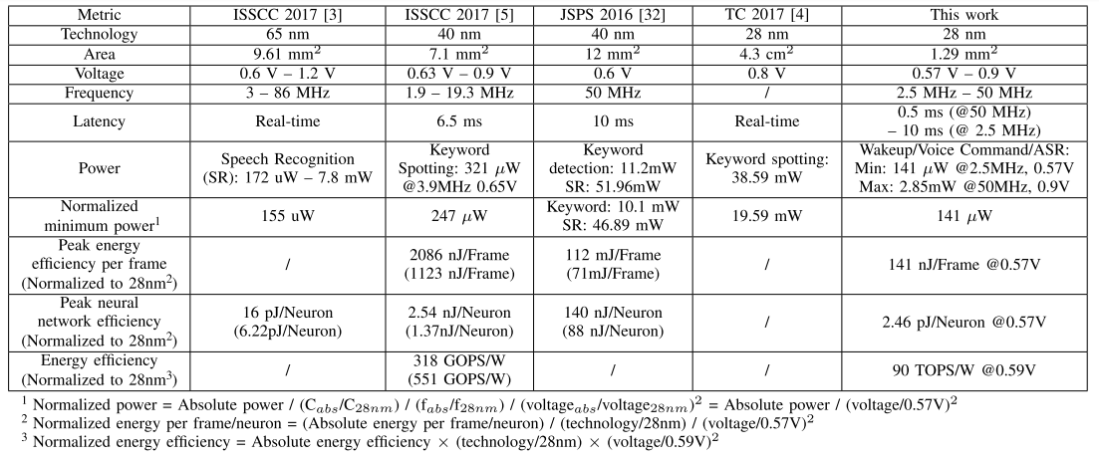
Results

Slide 7
DDR Rate
DDR | Bus Clock (MHz) | Internal Rate (MHz) | Transfer Rate (MT/s) | Voltage
DDR | 100-200 | 100-200 | 200-400 | 2.5
DDR2 | 200-533 | 100-266 | 400-1066 | 1.8
DDR3 | 400-1066 | 100-266 | 800-2400 | 1.5
DDR4 | 800-1200 | 200-300 | 1600-5067 | 1.2

